Slide 1
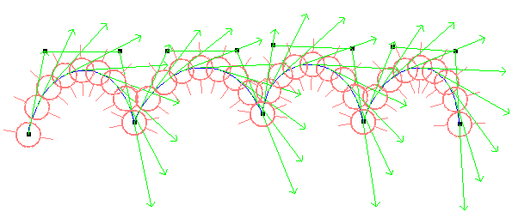
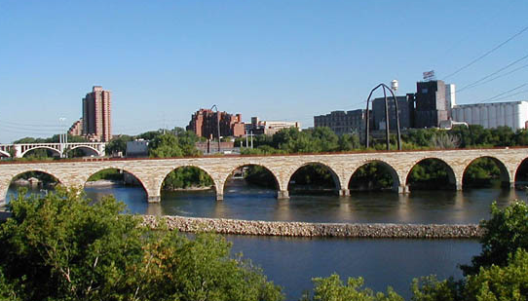
CS3241 : Let’s Get Twisted
Lab #4

Slide 2
Goals
Understanding Bezier Curves
Drawing by iterative method
Understanding tangent vectors and C1 continuity

Slide 3
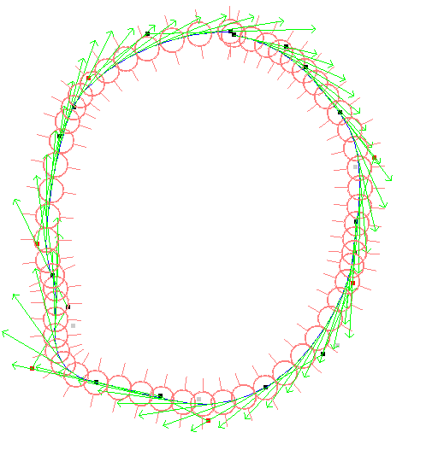
What you are given
A skeleton main.cpp file:
GLUT mouse handler to add points on screen
Reshape function to resize the screen
File handlers to read and write savefile.txt
Constants you should use to draw the curve: #define NLINESEGMENT 32 #define NOBJECTONCURVE 8
Data structures to record control points struct Point {
int x, y;
};
int nPt = 0;
Point ptList[ MAXPTNO ];

Slide 4
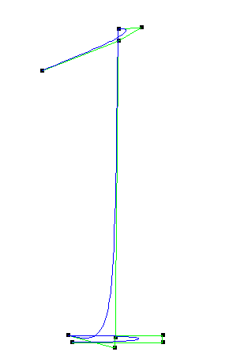
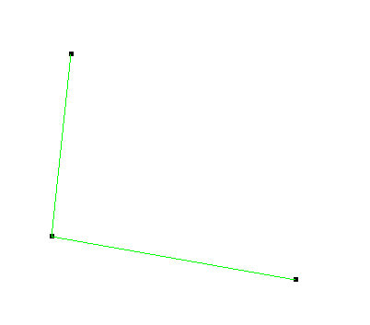
Draw Control Lines
Connect the adjacent points
Placeholder provided in the display() function
ptList[0]
ptList[1]
ptList[2]

Slide 5
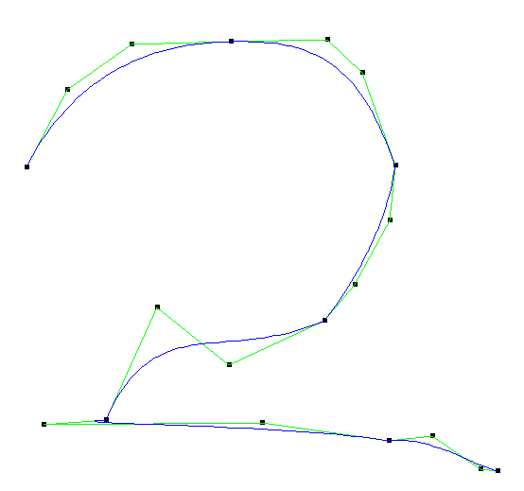
Implement Erase Function
Remember to implement ‘Erase’ function
What is the easist way to “eliminate” all the points ON THE SCREEN?
ptList[0]
ptList[1]
ptList[2]

Slide 6
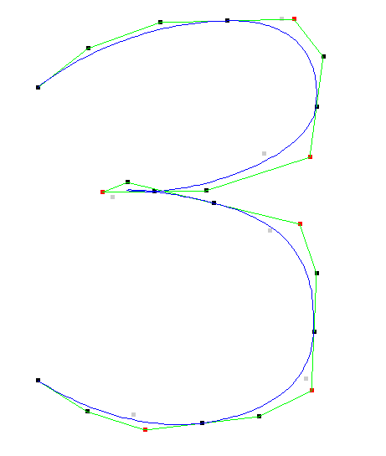
Draw Curve
Connect the 4 points in a curve by drawing NLINESEGMENT smaller lines
Use the iterative method shown in lecture
Order of the curve: n=4
t ranges from 0 to 1 in NLINESEGMENT (default 32) steps

Slide 7
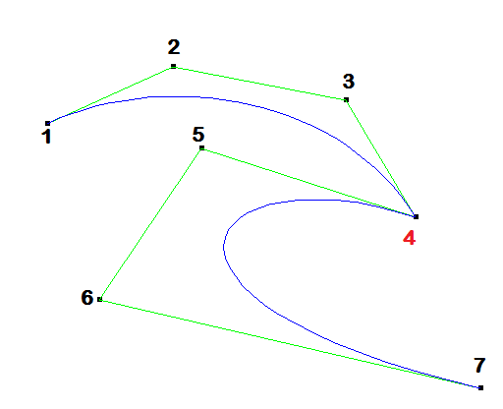
Draw Curve
Reminder:
Use Points 1-4 for first point,
Points 4-7 for second etc as each adjacent cubic Bezier curve section has a common start/end point.

Slide 8
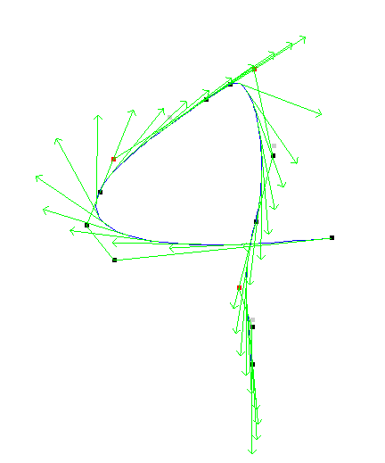
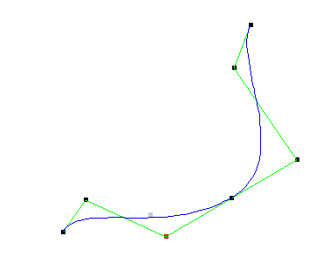
Implement C1 Continuity
For two curves (with same degrees) with control points {p1, p2, p3, p4} and {q1,q2,q3,q4}
They are C1 Continuous if
p4-p3 = q2-q1
We know p3 and p4
How to find q2?
q2
p4=q1
p3

Slide 9
Implement C1 Continuity
Remember:
Draw the grayed out C0 point
The C0/C1 transformation must be reversible
All functions must work in either mode.
C0 p11
p02
P10=p03
p11

Slide 10
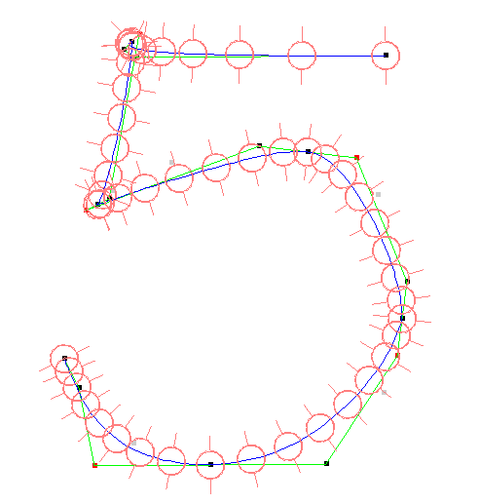
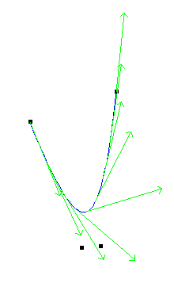
Draw Tangents
Use differentiation of Bezier function to compute tangent at each step
NOOBJECTONCURVE (default 8) objects – NOT NLINESEGMENTS
drawRightArrow() has been provided
The arrow needs to be (1) positioned correctly (2) oriented correctly

Slide 11
Tangent revised
The tangent represents the velocity at the particular point.
The tangent is obtained by differentiating the equation for the point

Slide 12
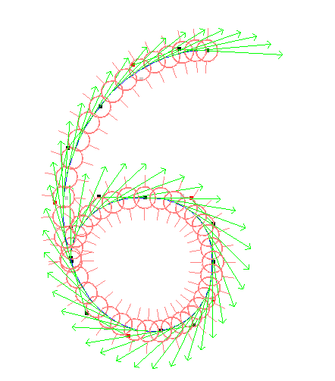

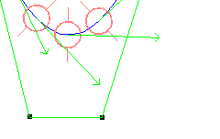
Draw Object
Draw any object you like along the curve
NOOBJECTONCURVE (default 8) objects – same as tangents
Objects must be oriented relative to tangent
You can reuse your Lab1 result!

Slide 13
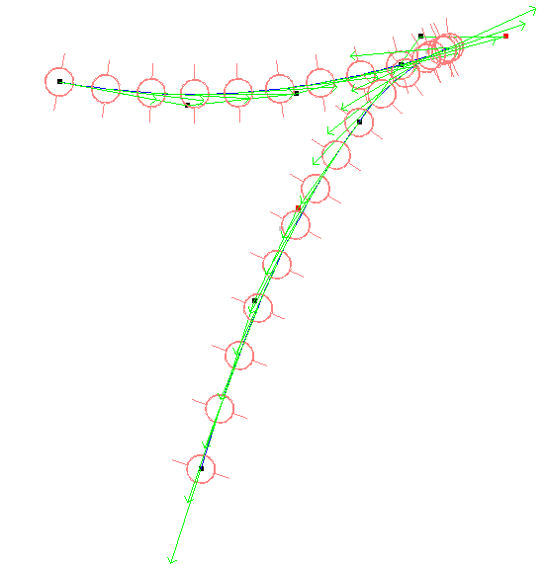
Final Drawing
Draw a beautiful figure with a Bezier curve and your object.
Default name is “savefile.txt”
Functionality to do this has been provided for you in the skeleton
“W” writes, “R” reads

Slide 14
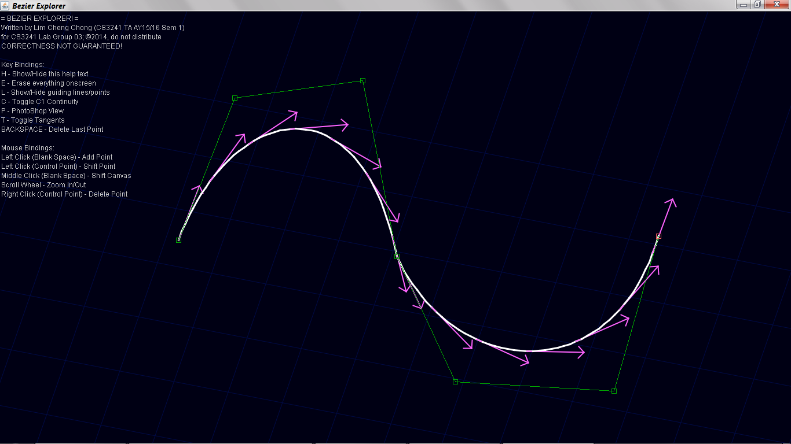
Need Extra Help?
A TA for this module has written a Java program based on this assignment, if you are still confused about Bezier curves. http://bit.ly/cc_cs3241_bezier

